Slide 1
Serverless Architecture

Slide 2

Hello!
I am Hassan Murtaza
DevOps/Cloud Engineer @OneByte
You can find me at
Writes at hassanmurtaza.com
Open Sources at github.com/MrHassanMurtaza

Slide 3
What’s the Agenda
Journey to Serverless
What is Serverless
Why Serverless
Serverless in Production
Serverless Frameworks
Demo

Slide 4
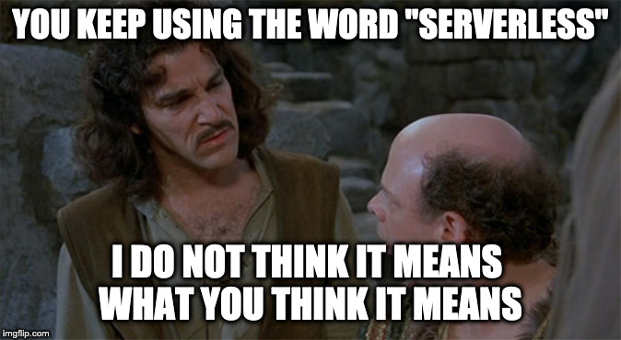

Slide 5
How we got here?
Infrastructure as a service (IAAS)
Serverless (FAAS)
On Premise
Cloud & Virtualization
Platform as a service (PAAS)

Slide 6


Slide 7
What is Serverless
Why are we here today? What the heck is serverless?

Slide 8
In a nutshell, serverless is a cloud computing architecture that allows developers to build and run code without having to manage, provision, or monitor infrastructure.

Slide 9
Why Serverless
No Infrastructure Provisioning
No management of servers
Autoscaling / Load Balancing
Pay for Value
Highly Available and Secure
Multiple Runtimes
Quick release to production

Slide 10
Supports Multiple Runtimes
NodeJS
Python
GO
Ruby
C#
Java

Slide 11


Slide 12
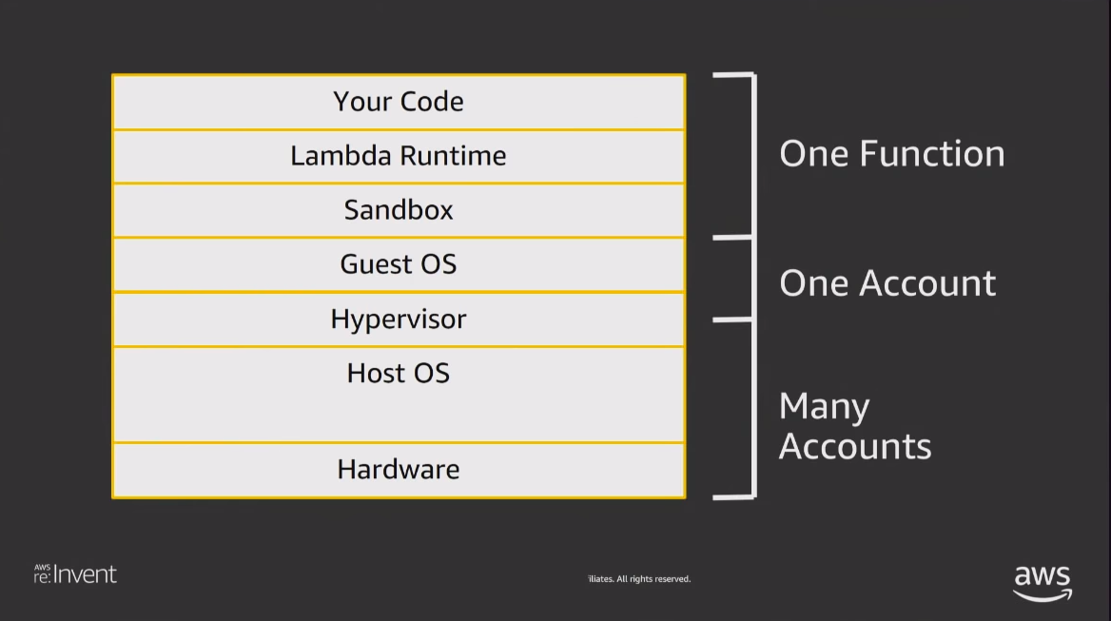

Slide 13
Serverless Frameworks
Zappa for Python
Serverless Framework NodeJS
Chalice
Serverless Application Model (SAM) by AWS

Slide 14
Serverless in Production
Possibilities are limitless but let’s discuss some common use cases.

Slide 15
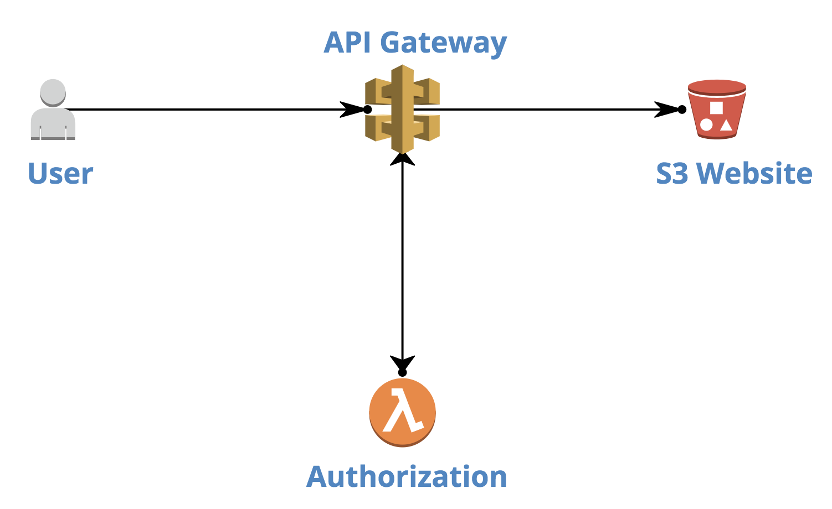
Simple Website with Backend Logic

Slide 16
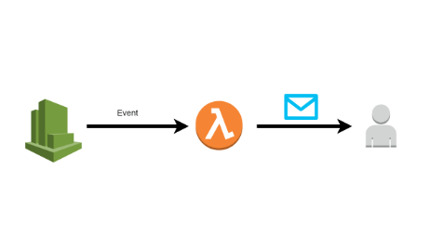
Automating Regular Jobs

Slide 17
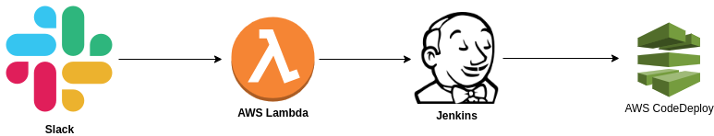
How we are using Serverless at OneByte

Slide 18


Slide 19
Enough Talk! Let’s Demo;

Slide 20
Demo on AWS Console

Slide 21
Demo using Serverless Framework Offline

Slide 22
Demo using Serverless Framework

Slide 23
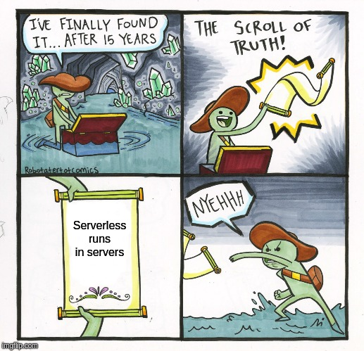

Slide 24
Thanks!
Any questions?
You can find me at hassanmurtaza.com or
email me at mrhassanmurtaza@gmail.com

Slide 25
We are Looking for DevOps!
Email resume: hassan.murtaza@onebyte.biz

